Slide 1
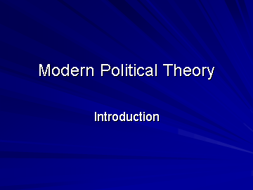

Slide 2

Key themes: 1) Power and Authority
What is the basis for political authority?
Why should we obey the law?
What are the appropriate limits to political authority?

Slide 3
Key Themes: 2) Property and Equality
Is private property justified?
What is a fair distribution of goods in society?
Can inequality be justified?

Slide 4
Key Themes 3: Democracy and the General Will
How is democratic society constituted?
Does democracy make government legitimate?
Is our modern conception of representative democracy sufficient?

